Slide 1
FACE
MALE FEMALE
FACE
ASIAN CAUCASIAN
WORD
OBJECT NON-OBJECT
WORD
1 SYLLABLE 2 SYLLABLES

Slide 2

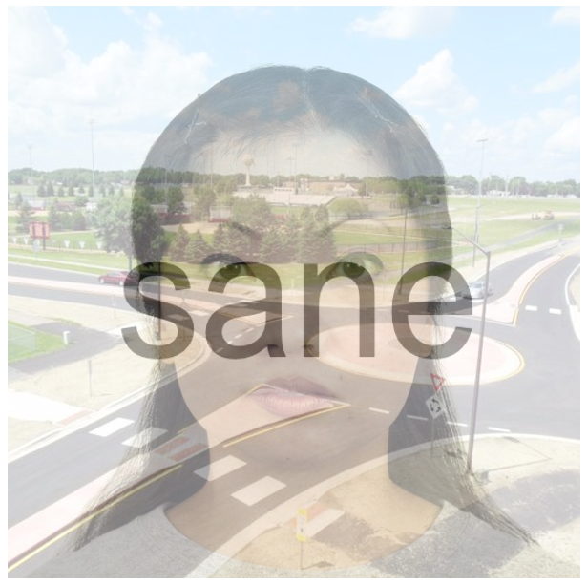
WORD
OBJECT NON-OBJECT
0.5 s
FACE
ASIAN CAUCASIAN
up to 3 s
0.5 s
up to 3 s

Slide 3
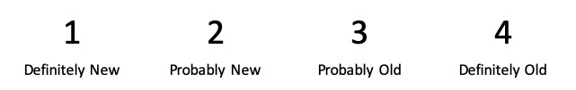

kidney
+
+

